Slide 1
COMPUTER ORGANIZATION AND ARCHITECTURE
Dr. Rizwan Khan
Head – Department of Computer Science and Engineering
(An NBA Accredited Program)
ABES Institute of Technology, Ghaziabad

Slide 2
MODES OF TRANSFER - INTERRUPT INITIATED I/O & DMA
Modes of Transfer
Interrupt Initiated I/O
Polling takes valuable CPU time
Open communication only when some data has to be passed -> Interrupt.
I/O interface, instead of the CPU, monitors the I/O device
When the interface determines that the I/O device is ready for data transfer, it generates an Interrupt Request to the CPU
Upon detecting an interrupt, CPU stops momentarily the task it is doing, branches to the service routine to process the data transfer, and then returns to the task it was performing
DMA (Direct Memory Access)
Large blocks of data transferred at a high speed to or from high speed devices, magnetic drums, disks, tapes, etc.
DMA controller
Interface that provides I/O transfer of data directly to and from the memory and the I/O device
CPU initializes the DMA controller by sending a memory address and the number of words to be transferred
Actual transfer of data is done directly between the device and memory through DMA controller
Freeing CPU for other tasks

Slide 3
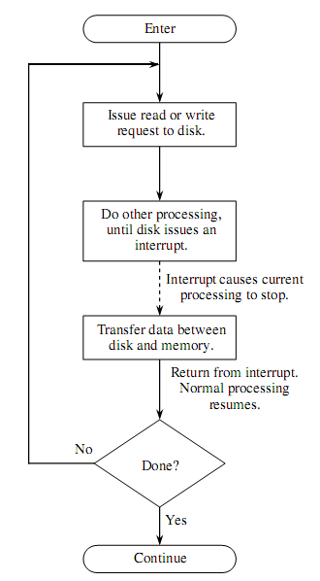
Interrupt Driven I/O
Interrupt Service Routine (ISR)
Vectored Interrupt
Non-vectored Interrupt
Priority of Interrupts
Maskable Interrupts
Non Maskable Interrupts

Slide 4
Interrupts and ISR
Priority Interrupt
In a number of conditions the processor may be interrupted from its normal processing activity. Some of these conditions are :
Power failure as detected by a sensor
Arithmetic conditions such as overﬂow and underﬂow
Illegal data or illegal instruction code
Errors in data transmission and storage
Software-generated interrupts (as intended by the user)
Normal completion of asynchronous transfer.
An interrupt service routine is a program preloaded into the machine memory that performs the following functions:
Disables further interrupts temporarily.
Saves the processor status (all registers).
Enables further interrupts.
Determines the cause of interrupt.
Services the interrupt.
Disables interrupts.
Restores processor status.
Enables further interrupts.
Returns from interrupt.

Slide 5


